Slide 1
MOD006671
Quantitative Methods for Banking and Finance
Week 3: Introduction to Data Analytics

Slide 2
Topics for today
- Introduction
- Types of data
- Measures of Centre and Dispersion

Slide 3
Uses of quantitative analysis in Finance
Making business decisions
Make investment decisions
Undergoing a corporate transaction
Pricing securities

Slide 4
Application of statistical methods
Time-series analysis and forecasting
Correlation and regression analysis
Estimation and significance testing
Decision-making under conditions of risk and uncertainty
Break-even analysis
Syllabus!!

Slide 5
Types of Data and Notation
In general, data may be quantitative (e.g. exchange rates, stock prices, number of shares outstanding), or qualitative (e.g. day of the week).
Quantitative variables are those that take a numerical value. Examples include:
time taken to complete a journey;
heights of adult students in a school;
number of customers entering a store each day;
number of rejects in a production run etc.
Qualitative variables (also called attributes) are those that take nonnumerical values (i.e. they are not numbers). Examples include:
eye colour;
favourite foods
Notes:
Variables may be either quantitative or qualitative. Quantitative variables, to which we shall restrict discussion here, are those for which observations are numerical in nature. Qualitative variables have non-numeric observations, such as colour of hair, although of course each possible non-numeric value may be associated with a numeric frequency.

Slide 6
Continuous and Discrete Data
Continuous data can take on any value and are not confined to take specific numbers.
  Their values are limited only by precision.
    For example, the rental yield on a property could be 6.2%, 6.24%, or 6.238%.
On the other hand, discrete data can only take on certain values, which are usually integers
  For instance, the number of people in a particular underground carriage or the number of shares traded during a day.
They do not necessarily have to be integers (whole numbers) though, and are often defined to be count numbers.
  For example, until recently when they became ‘decimalised’, many financial asset prices were quoted to the nearest 1/16 or 1/32 of a dollar.
Notes:
There are two different types of quantitative variables. Variables may be either continuous or discrete. A continuous variable may take any value between two stated limits (which may possibly be minus and plus infinity). Height, for example, is a continuous variable, because a person's height may (with appropriately accurate equipment) be measured to any minute fraction of a millimetre. A discrete variable however can take only certain values occurring at intervals between stated limits. For most (but not all) discrete variables, these intervals are the set of integers (whole numbers).
For example, if the variable is the number of children per family, then the only possible values are 0, 1, 2, ... etc., because it is impossible to have other than a whole number of children. However in Britain shoe sizes are stated in half-units, and so here we have an example of a discrete variable which can take the values 1, 1½, 2, 2½, etc.
You may possibly see the difference between continuous and discrete variables stated as "continuous variables are measured, whereas discrete variables are counted". While this is possibly true in the vast majority of cases, you should not simply state this if asked to give a definition of the two types of variables.

Slide 7
Cardinal, Ordinal and Nominal Numbers
Another way in which we could classify numbers is according to whether they are cardinal, ordinal, or nominal.
Cardinal numbers are those where the actual numerical values that a particular variable takes have meaning, and where there is an equal distance between the numerical values.
  Examples of cardinal numbers would be the price of a share or of a building, and the number of houses in a street.
Ordinal numbers can only be interpreted as providing a position or an ordering.
  Thus, for cardinal numbers, a figure of 12 implies a measure that is `twice as good' as a figure of 6. On the other hand, for an ordinal scale, a figure of 12 may be viewed as `better' than a figure of 6, but could not be considered twice as good. Examples of ordinal numbers would be the position of a runner in a race.
Notes:
Skilled data analysts spend a great deal of time and effort in planning a data collection effort. They begin by considering the type of data they can and will collect in light of their goals for the use of the data. Just as carpenters are careful in selecting their tools, so are analysts in their choice of data. You cannot ask a low precision tool to perform high precision work. The same is true for data. A good analyst is cognizant of the types of analyses they can perform on various categories of data. This is particularly true in statistical analysis, where there are often rules for the types of analyses that can be performed on various types of data.
The standard characteristics that help us categorize data are presented in Table 2.1. Each successive category permits greater measurement precision and also permits more extensive statistical analysis. Thus, we can see from Table 2.1 that ratio data measurement is more precise than nominal data measurement. It is important to remember that all these forms of data, regardless of their classification, are valuable, and we collect data in different forms by considering availability and our analysis goals. For example, nominal data are used in many marketing studies, while ratio data are more often the tools of finance, operations, and economics; yet, all business functions collect data in each of these categories. For nominal and ordinal data, we use non-metric measurement scales in the form of categorical properties or attributes. Interval and ratio data are based on metric measurement scales allowing a wide variety of mathematical operations to be performed on the data. The major difference between interval and ratio measurement scales is the existence of an absolute zero for ratio scales and arbitrary zero points for interval scales. For example, consider a comparison of the Fahrenheit and Celsius temperature scales. The zero points for these scales are arbitrarily set and do not indicate an “absolute absence” of temperature. Similarly, it is incorrect to suggest that 40◦ Celsius is half as hot as 80◦ Celsius. By contrast, it can be said that 16 ounces of coffee is, in fact, twice as heavy as 8 ounces.

Slide 8
Cardinal, Ordinal and Nominal Numbers (Cont’d)
Nominal numbers occur where there is no natural ordering of the values at all.
  Such data often arise when numerical values are arbitrarily assigned, such as telephone numbers or when codings are assigned to qualitative data (e.g. when describing the exchange that a US stock is traded on).
Cardinal, ordinal and nominal variables may require different modelling approaches or at least different treatments.

Slide 9
Types of Data and Notation
There are 3 types of data which we might use for quantitative analysis:
1. Cross-sectional data
  Individual observations measured at a given point in time
2. Time series data
  Observations measured at different points in time
3. Panel data, a combination of 1. & 2.
  A cross-section of observations is followed through time
Notes:
Data collected from a sample of units (e.g. individuals, firms or government departments) for a single time period is called cross-section data. For example, the test scores obtained by 20 management trainees in a company in 2007 would represent a sample of cross-section data. On the other hand, data collected for a single unit (e.g. a single individual, firm or government department) at multiple time periods are called time-series data. For example, annual data on the UK inflation rate from 1985–2007 would represent a sample of time-series data. Sometimes it is possible to collect cross-section over two or more time periods – the resulting data set is called a panel data or longitudinal data set.

Slide 10
Cross-Sectional Data
Cross-sectional data is data collected at one point in time for many entities.
Examples
Profit of 50 banks in 2024
Share prices of 10 companies on 1st Jan 2025
Income of 100 customers in one year
Key Features
One time period
Many individuals/firms/banks
Used to compare entities

Slide 11
Time-Series Data
Time-series data is data collected over many time periods for one entity.
Examples
Stock price of SBTT from 2015–2025
GDP of T&T for 10 years
Monthly inflation rate
Key Features
One entity
Multiple time periods
Used for trend & forecasting

Slide 12
Panel Data
Panel data is a combination of cross-sectional and time-series data.
Examples
Profits of 10 banks over 5 years
Share prices of 20 companies for 10 years
Why banks and finance use it
Better forecasting
More accurate financial models

Slide 13
Comparison of Time Series versus Cross-sectional Data
Examples of Problems that Could be Tackled Using a Time Series Regression
- How the value of a country’s stock index has varied with that country’s
macroeconomic fundamentals.
- How the value of a company’s stock price has varied when it announced the value of its dividend payment, or issue of debt.
- The effect on a country’s currency of an increase in its interest rate.
Cross-sectional data is data on one or more variables collected at a single point in time, e.g.
- A poll of usage of internet stock broking services.
- Cross-section of stock returns on the New York Stock Exchange.
- A sample of bond credit ratings for UK banks.

Slide 14
Comparison of Cross-sectional and Panel Data
Examples of Problems that Could be Tackled Using a Cross-Sectional Regression
- The relationship between company size and the return to investing in its shares
- The relationship between a country’s GDP level and the probability that the
government will default on its sovereign debt.
Panel Data has the dimensions of both time series and cross-sections, e.g. the daily prices of a number of blue chip stocks over two years.
It is common to denote each observation by the letter t and the total number of observations by T for time series data, and to denote each observation by the letter i and the total number of observations by N for cross-sectional data.

Slide 15
There are 3 types of data which we might use for quantitative analysis:
1. Time series data
  Observations measured at different points in time
2. Cross-sectional data
  Individual observations measured at a given point in time
3. Panel data, a combination of 1. & 2.
  A cross-section of observations is followed through time

Slide 16
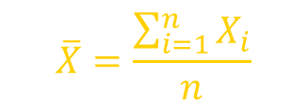

Measures of Central Tendency
Central Tendency
Arithmetic Mean
Median
Mode
Geometric Mean
$$\overline{X}=\frac{\sum_{i=1}^{n}{X_{i}}}{n}$$
$${\overline{X}}_{G}=(X_{1}×X_{2}×…×X_{n})^{\frac{1}{n}}$$
Middle value in the ordered array
Most frequently observed value
Rate of change of
a variable over time

Slide 17
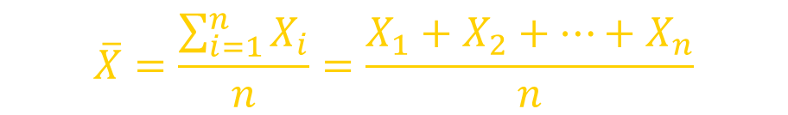
Measures of Central Tendency:
The Mean
The arithmetic mean (often just called the “mean”) is the most common measure of central tendency
  For a sample of size n:
The i^{th} value
Pronounced x-bar
$$\overline{X}=\frac{\sum_{i=1}^{n}{X_{i}}}{n}=\frac{X_{1}+X_{2}+…+X_{n}}{n}$$
Sample size
Observed values

Slide 18
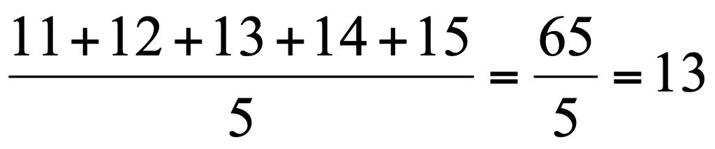
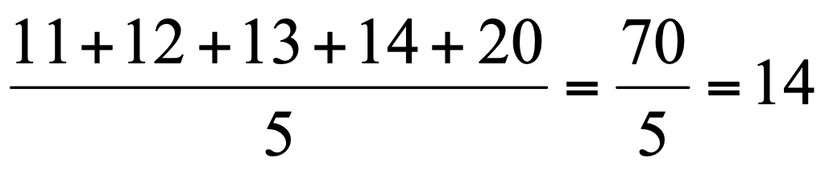
Measures of Central Tendency: The Mean
The most common measure of central tendency
Mean = sum of values divided by the number of values
Affected by extreme values (outliers)
11 12 13 14 15 16 17 18 19 20
11 12 13 14 15 16 17 18 19 20
Mean = 13
Mean = 14

Slide 19
Measures of Central Tendency: The Median
In an ordered array, the median is the “middle” number (50% above, 50% below)
Not affected by extreme values
11 12 13 14 15 16 17 18 19 20
11 12 13 14 15 16 17 18 19 20
Median = 13
Median = 13

Slide 20
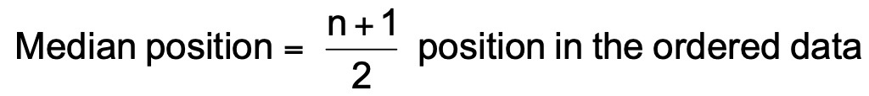
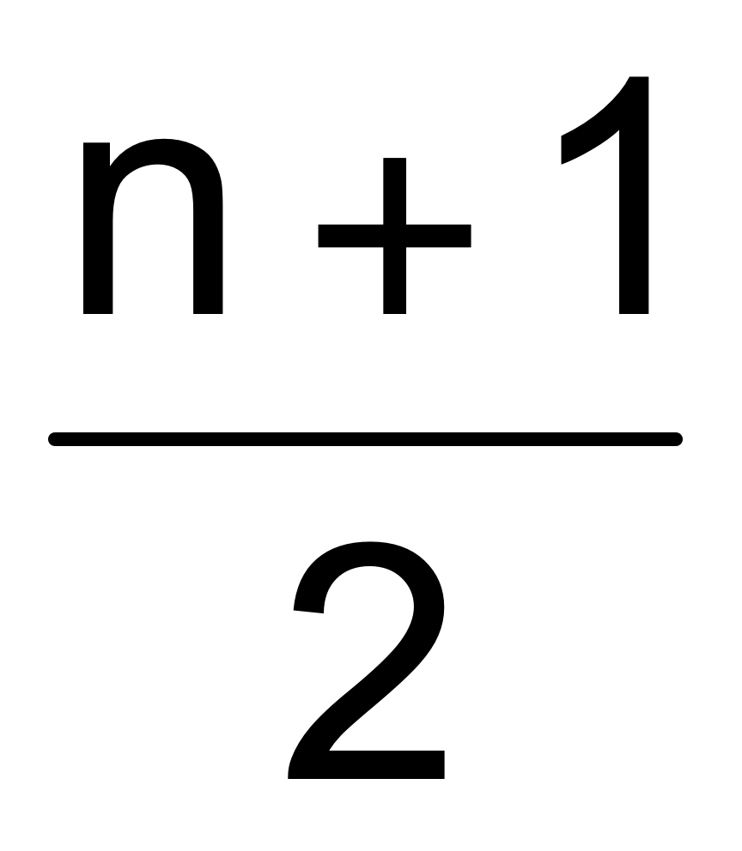
Measures of Central Tendency:
Locating the Median
The location of the median when the values are in numerical order (smallest to largest):
If the number of values is odd, the median is the middle number
If the number of values is even, the median is the average of the two middle numbers
Note that is not the value of the median, only the position of
the median in the ranked data

Slide 21
Measures of Central Tendency: The Mode
Value that occurs most often
Not affected by extreme values
Used for either numerical or categorical (nominal) data
There may may be no mode
There may be several modes
0 1 2 3 4 5 6 7 8 9 10 11 12 13 14
0 1 2 3 4 5 6
Mode = 9
No Mode

Slide 22
Practice – Measures of Central Tendency
House Prices:
$2,000,000
$ 500,000
$ 300,000
$ 100,000
$ 100,000
Sum $ 3,000,000
Required:
Please calculate mean, median & mode?
What do these figures indicate, respectively?

Slide 23
Measures of Central Tendency:
Review Example
Mean: ($3,000,000/5)
= $600,000
Median: middle value of ranked data
= $300,000
Mode: most frequent value
= $100,000
House Prices:
$2,000,000
$ 500,000
$ 300,000
$ 100,000
$ 100,000
Sum $ 3,000,000

Slide 24
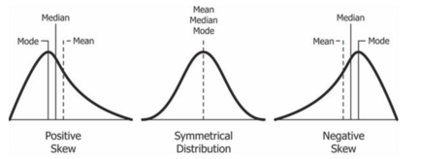
Distributions
A distribution is simply a collection of data, or scores, on a variable. Usually, these scores are arranged in order from smallest to largest and then they can be presented graphically.

Slide 25
Measures of Central Tendency:
Which Measure to Choose?
The mean is generally used, unless extreme values (outliers) exist.
The median is often used, since the median is not sensitive to extreme values. For example, median home prices may be reported for a region; it is less sensitive to outliers.
In some situations it makes sense to report both the mean and the median.

Slide 26
What if with a strongly skewed distribution?
When is the mean the best measure of central tendency?
When is the mode the best measure of central tendency?
When is the median the best measure of central tendency?
When your data distribution is continuous and symmetrical, i.e. normally distributed
The least used of the measures
Only be used when dealing with nominal data
When your data set is skewed, or you are dealing with ordinal data

